Slide 1

OOSA&D(2017) 08 封装算法: 模板方法模式
08 Encapsulating Algorithms : the Template Method Pattern

Slide 2
Glossary
Encapsulation 封装
method invocation 方法调用
Recipe [ˈresəpi] 配方
Brew酿造； 泡，煮
Steep浸泡
Skeleton [ˈskelɪtn] 骨架
Dalian Neusoft University of Information © Copyright

Slide 3
Agenda
A Case Analysis
Design Pattern: the Template Method Pattern
An Application for example
An experiment in class
Practices of design pattern as homework
Dalian Neusoft University of Information © Copyright

Slide 4
Agenda
A Case Analysis
Design Pattern: the Template Method Pattern
An Application for example
An experiment in class
Practices of design pattern as homework
Dalian Neusoft University of Information © Copyright

Slide 5
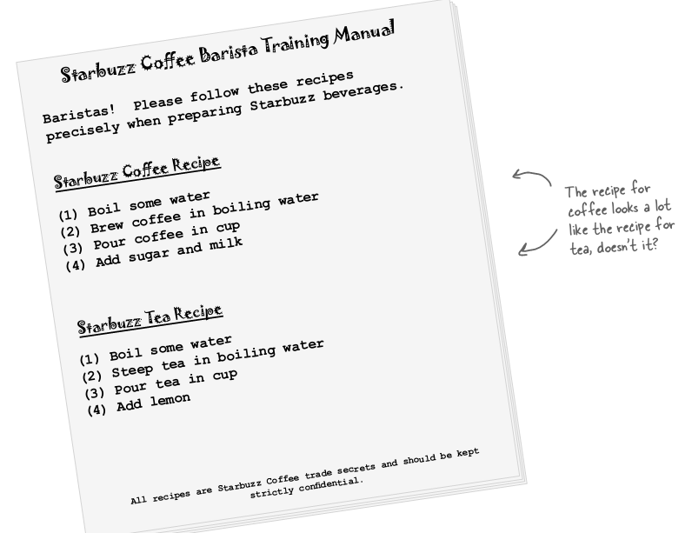
1. A Case Analysis
It’s time for some more caffeine
Dalian Neusoft University of Information © Copyright

Slide 6
1. A Case Analysis
Here’s the coffee:
Dalian Neusoft University of Information © Copyright

Slide 7
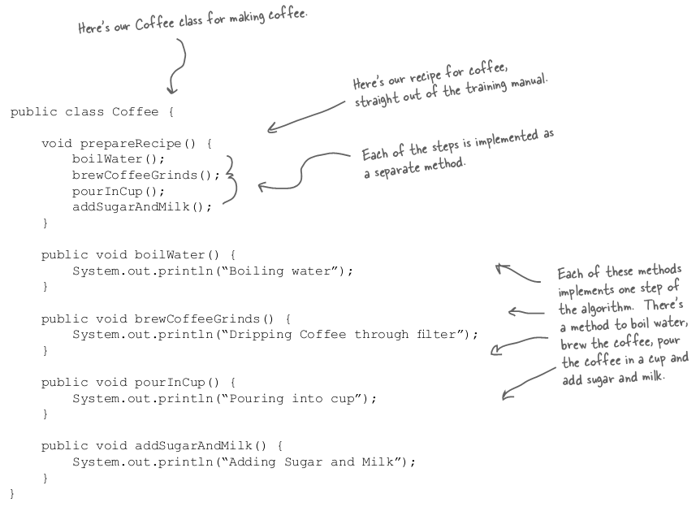
1. A Case Analysis
Dalian Neusoft University of Information © Copyright

Slide 8
1. A Case Analysis
and now the Tea...
Dalian Neusoft University of Information © Copyright

Slide 9
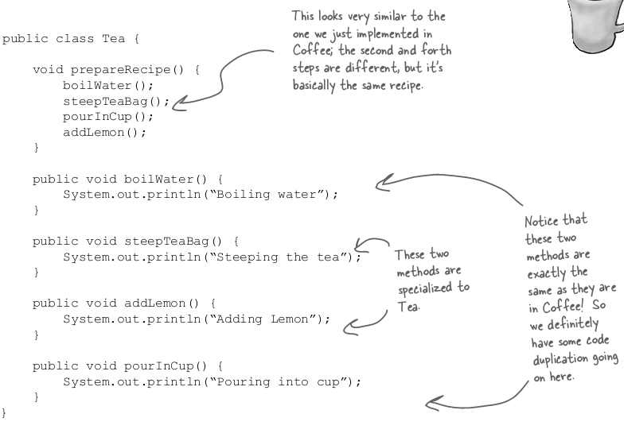
1. A Case Analysis
and now the Tea...
Dalian Neusoft University of Information © Copyright

Slide 10
1. A Case Analysis
Sir, may I abstract your Coffee, Tea?
Dalian Neusoft University of Information © Copyright

Slide 11
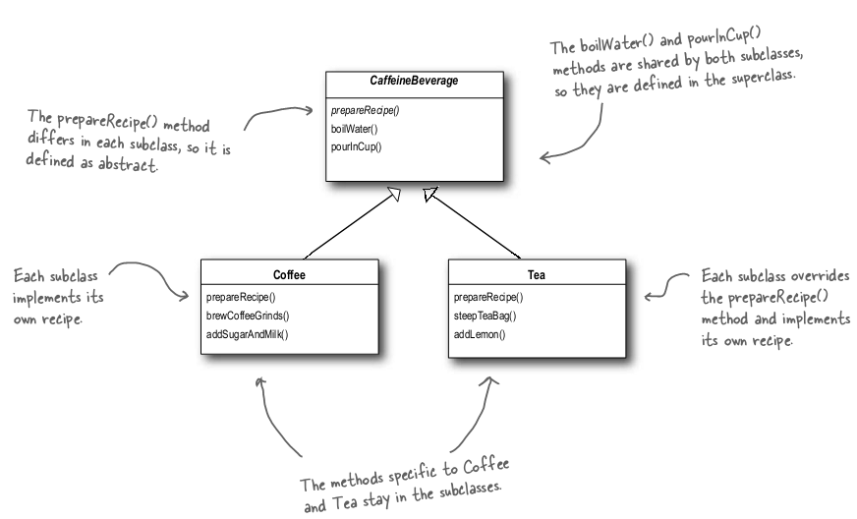
1. A Case Analysis
Sir, may I abstract your Coffee, Tea?
Dalian Neusoft University of Information © Copyright

Slide 12
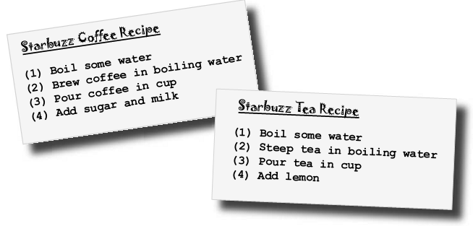
1. A Case Analysis
Taking the design further...
Dalian Neusoft University of Information © Copyright

Slide 13
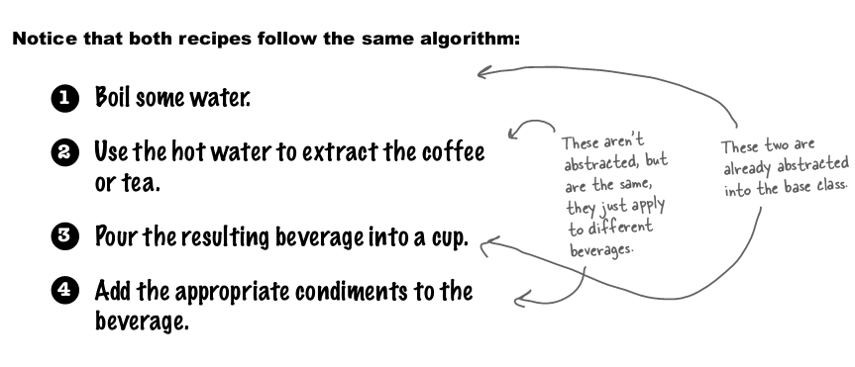
1. A Case Analysis
Dalian Neusoft University of Information © Copyright

Slide 14
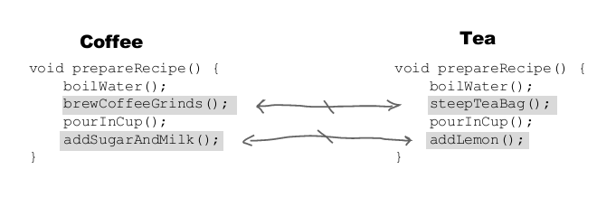
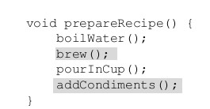
1. A Case Analysis
Abstracting prepareRecipe()
Dalian Neusoft University of Information © Copyright

Slide 15
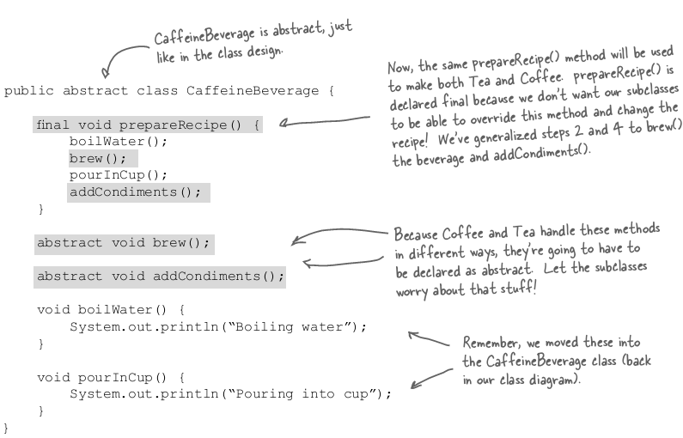
1. A Case Analysis
Dalian Neusoft University of Information © Copyright

Slide 16
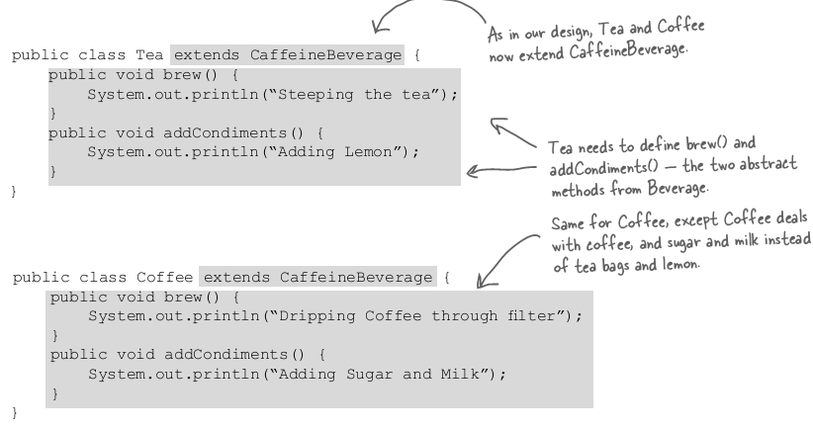
1. A Case Analysis
Dalian Neusoft University of Information © Copyright

Slide 17
1. A Case Analysis
What have we done?
Dalian Neusoft University of Information © Copyright

Slide 18
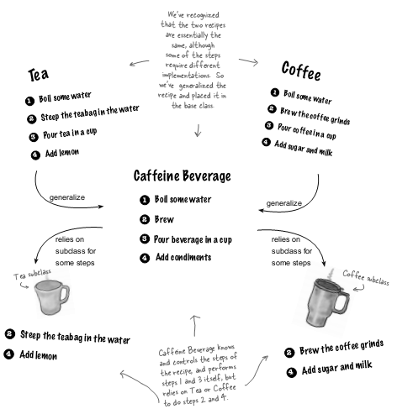
1. A Case Analysis
Dalian Neusoft University of Information © Copyright

Slide 19
1. A Case Analysis
Meet the Template Method
Dalian Neusoft University of Information © Copyright

Slide 20
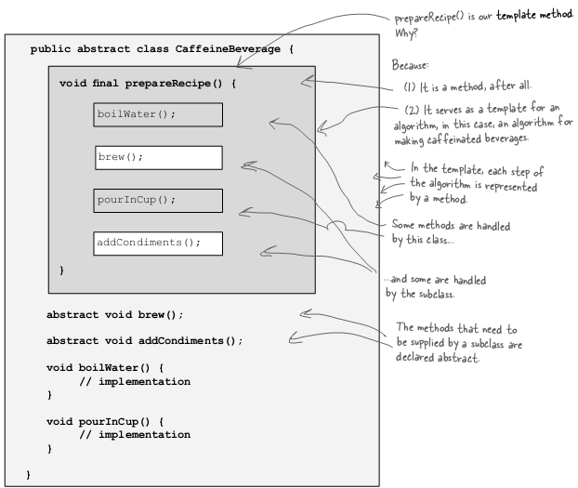
1. A Case Analysis
Meet the Template Method
Dalian Neusoft University of Information © Copyright

Slide 21
1. A Case Analysis
Let’s make some tea...
Dalian Neusoft University of Information © Copyright

Slide 22
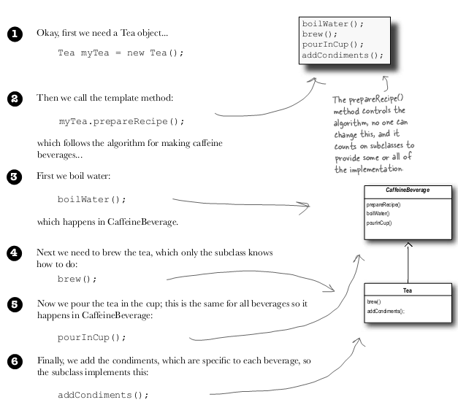
1. A Case Analysis
Meet the Template Method
Dalian Neusoft University of Information © Copyright

Slide 23
Agenda
A Case Analysis
Design Pattern: the Template Method Pattern
An Application for example
An experiment in class
Practices of design pattern as homework
Dalian Neusoft University of Information © Copyright

Slide 24
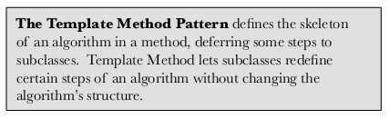

2. Design Pattern
Dalian Neusoft University of Information © Copyright

Slide 25
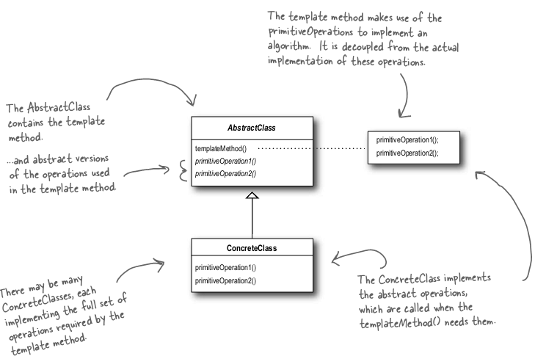
2. Design Pattern
the Template Method Pattern Class Diagram
Dalian Neusoft University of Information © Copyright

Slide 26
2. Design Pattern
how the AbstractClass is defined
abstract class AbstractClass {
final void templateMethod() {
primitiveOperation1();
primitiveOperation2();
concreteOperation();
}
abstract void primitiveOperation1();
abstract void primitiveOperation2();
void concreteOperation() {
// implementation here
}
}
Dalian Neusoft University of Information © Copyright

Slide 27
2. Design Pattern
abstract class AbstractClass {
final void templateMethod() {
primitiveOperation1();
primitiveOperation2();
concreteOperation();
hook();
}
abstract void primitiveOperation1();
abstract void primitiveOperation2();
final void concreteOperation() {
// implementation here
}
void hook() {}
}
We can also have concrete methods that do nothing by default; we call these “hooks.”
Subclasses are free to override these but don’t have to.

Slide 28
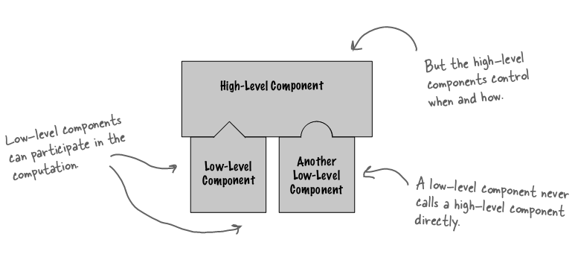
2. Design Pattern
The Hollywood Principle
Dalian Neusoft University of Information © Copyright

Slide 29
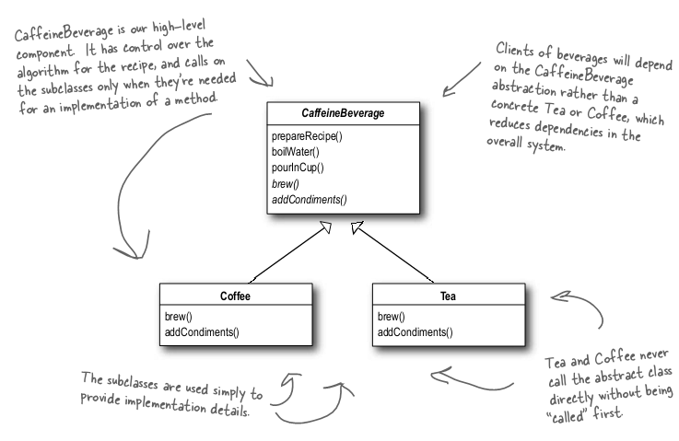
2. Design Pattern
The Hollywood Principle and Template Method
Dalian Neusoft University of Information © Copyright

Slide 30
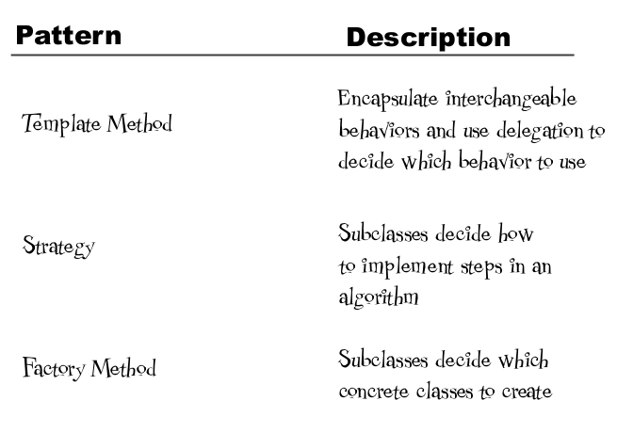
2. Design Pattern
Dalian Neusoft University of Information © Copyright

Slide 31

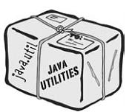
2. Design Pattern
Sorting with Template Method
private static void mergeSort(Object src[], Object dest[], int low, int high, int off)
{
for (int i=low; i<high; i++){
for (int j=i; j>low &&
((Comparable)dest[j-1]).compareTo((Comparable)dest[j])>0; j--)
{
swap(dest, j, j-1);
}
}
return;

Slide 32
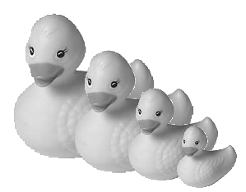
2. Design Pattern
Comparing Ducks
public class Duck implements Comparable {
String name;
int weight;
public Duck(String name, int weight) {
this.name = name;
this.weight = weight;
}
public String toString() {
return name + “ weighs “ + weight;
}
public int compareTo(Object object) {
Duck otherDuck = (Duck)object;
if (this.weight < otherDuck.weight) {
return -1;
} else if (this.weight == otherDuck.weight) {
return 0;
} else { // this.weight > otherDuck.weight
return 1;
}
}
}

Slide 33
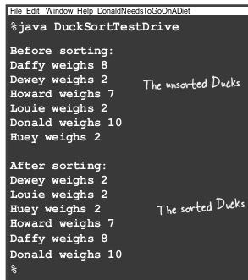
2. Design Pattern
Comparing Ducks
public class DuckSortTestDrive {
public static void main(String[] args) {
Duck[] ducks = {
new Duck(“Daffy”, 8),
new Duck(“Dewey”, 2),
new Duck(“Howard”, 7),
new Duck(“Louie”, 2),
new Duck(“Donald”, 10),
new Duck(“Huey”, 2)
};
System.out.println(“Before sorting:”);
display(ducks);
Arrays.sort(ducks);
System.out.println(“\nAfter sorting:”);
display(ducks);
public static void display(Duck[] ducks) {
for (int i = 0; i < ducks.length; i++) {
System.out.println(ducks[i]);
}
}
}
}

Slide 34
Agenda
A Case Analysis
Design Pattern: the Template Method Pattern
An Application for example
An experiment in class
Practices of design pattern as homework
Dalian Neusoft University of Information © Copyright

Slide 35
3. An Application for example
使用豆浆机制作纯豆浆（PureSoyaMilk）、红枣豆浆（ReddatesSoyaMilk）和核桃豆浆（NutSoyaMilk）。制作各种豆浆的程序：选材（selectMaterial）—>添加配料（addCondiments）—>浸泡（soak）—>放到豆浆机打碎（beat），通过添加不同的配料，可以制作出不同口味的豆浆，但是选材、浸泡和放到豆浆机打碎这几个步骤对于制作每种口味的豆浆都是一样的。
制作纯豆浆不需要添加调料。

Slide 36
PureSoyaMilk, ReddatesSoyaMilk, and NutSoyaMilk are made with soybean milk machine.Program: choice for all kinds of soybean milk (selectMaterial) - > add ingredients (addCondiments) - > soaking (soak) - > in the soybean milk maker break (beat), by adding different ingredients, can produce different flavors of soy milk, but materials, and soak in the soybean milk maker break these steps for the production of each flavor soya-bean milk are the same.
You don't need seasoning to make pure soy milk.

Slide 37
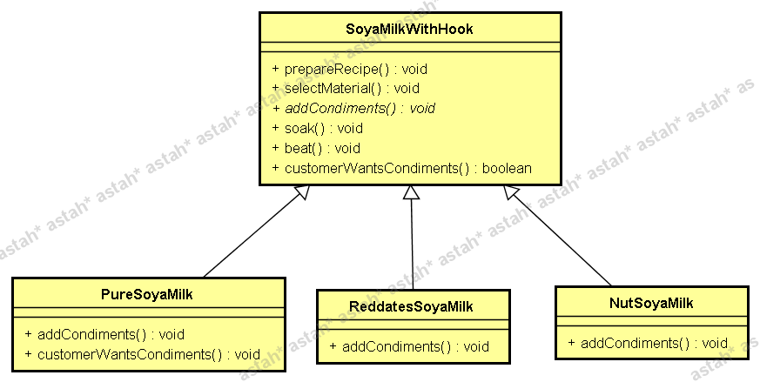
3. An Application for example

Slide 38
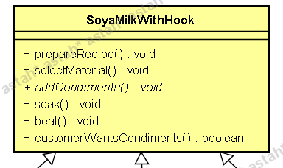
3. An Application for example

Slide 39
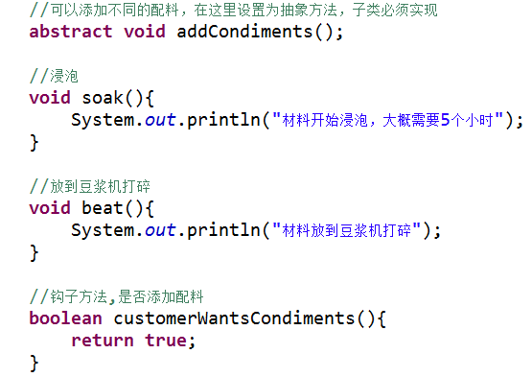
3. An Application for example

Slide 40
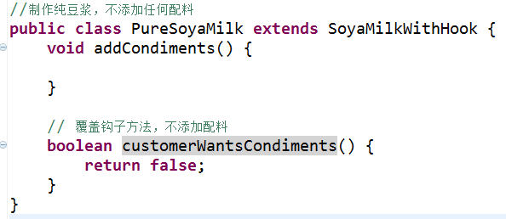
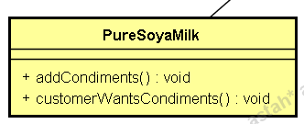
3. An Application for example

Slide 41
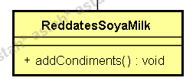
3. An Application for example

Slide 42
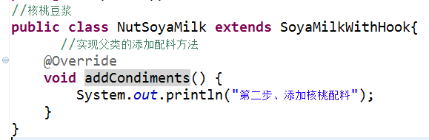
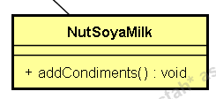
3. An Application for example

Slide 43
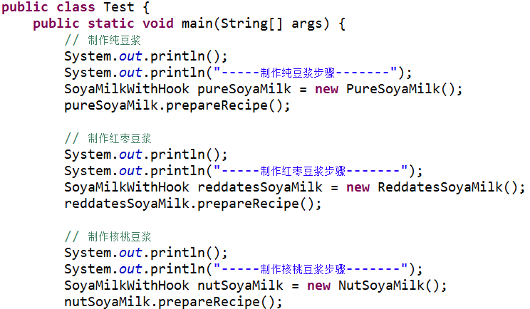
3. An Application for example

Slide 44
3. An Application for example

Slide 45
Agenda
A Case Analysis
Design Pattern: the Template Method Pattern
An Application for example
An experiment in class
Practices of design pattern as homework
Dalian Neusoft University of Information © Copyright

Slide 46
4. An experiment in class
Bank transactions
在银行办理业务时，一般都包含几个基本步骤，首先需要取号排队（getNumber），然后办理具体业务（doBusiness），最后根据储户的意愿可以对银行工作人员进行评分（judgeOrder），转帐业务可以不用评分。无论具体业务是取款（WithdrawMoney）、存款（Deposit）还是转账（Transfer），其基本流程都一样。现使用模板方法模式模拟银行业务办理流程。
Dalian Neusoft University of Information © Copyright

Slide 47
5. Homework
Finish the homework, which includes 3 tasks.
Dalian Neusoft University of Information © Copyright

